Slide 1
Lecture 6 Describe Quantitative Data with Numbers Mean, Median, Range and IQR

Slide 2
Learning Objects：
Calculate measures of center (mean, median).
Calculate and interpret measures of spread
(range, IQR,).

Slide 3
Measuring Center
Mean： the arithmetic average.
Median: the midpoint.

Slide 4
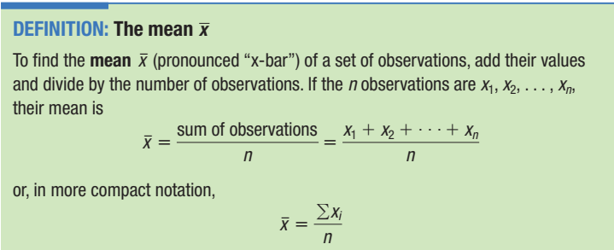
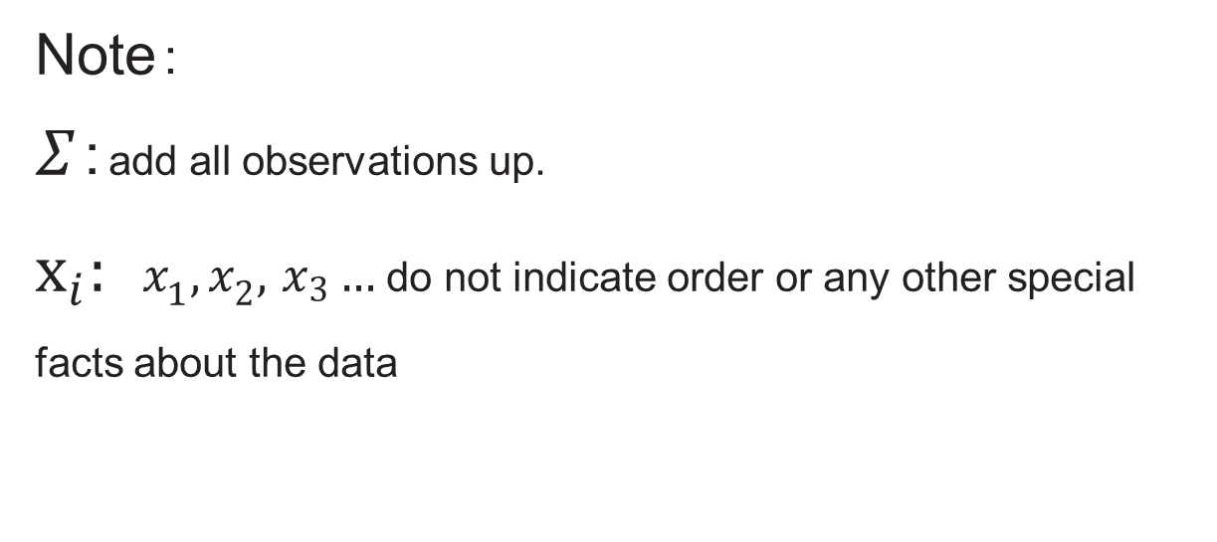

Slide 5
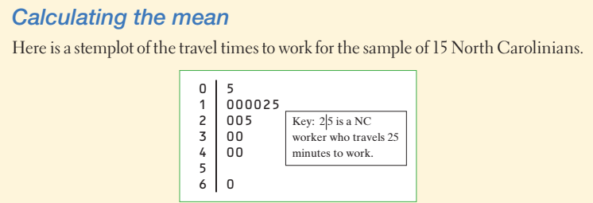
Problem: (a) How many workers are there?

Slide 6
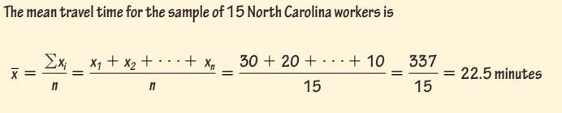
Problem:
(b)Find the mean travel time for all 15 workers.

Slide 7
Problem:
(c) What is the mean travel time for all workers
except the worker whose travel time is 60?
19.786
Much smaller than 22.5!!!!!

Slide 8
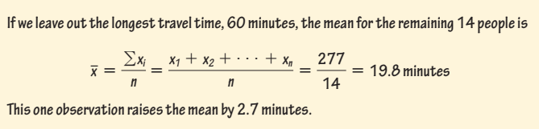
Weakness ☹
sensitive to the influence of extreme observations
These may be outliers, but a skewed distribution that has no outliers will also pull the mean toward its long tail. Because the mean cannot resist the influence of extreme observations, we say that it is not a resistant measure of center.
(c) Calculate the mean again, this time excluding the person who reported a 60-minute travel time to work. What do you notice?

Slide 9
Median
The median describes the midpoint of a distribution.
To find the median of a distribution:
Arrange all observations from smallest to largest.
If the number of observations n is odd, the median is the center observation in the ordered list.
If the number of observations n is even, the median is the average of the two center observations in the ordered list.

Slide 10
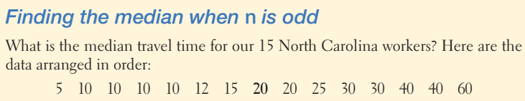
To find the median of a distribution when n is odd:
Arrange all observations from smallest to largest.
If the number of observations n is odd, the median is the center observation in the ordered list.
Answer:
The count of observations n = 15 is odd.
The bold 20 is the center observation in the ordered list, with 7 observations to its left and 7 to its right.
This is the median,20 minutes.

Slide 11
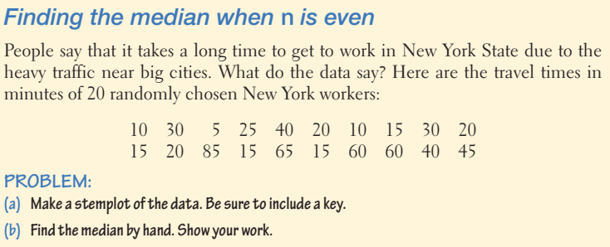
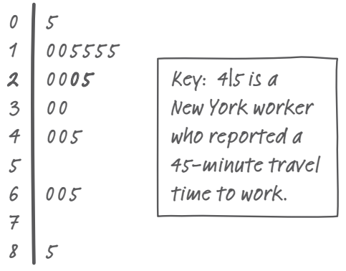

Slide 12
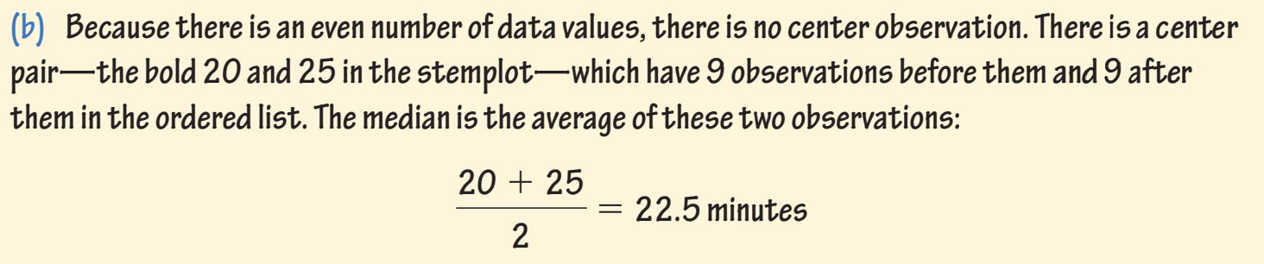

Slide 13
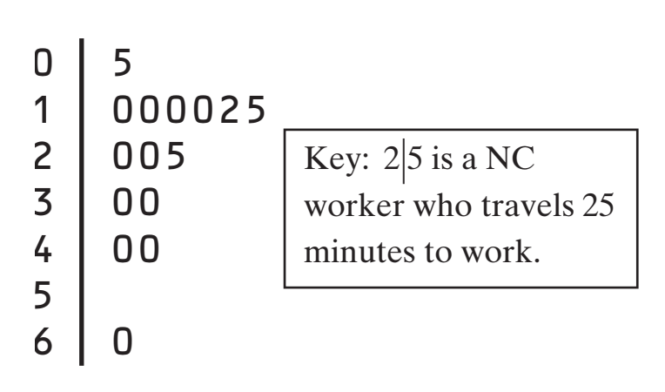
Mean & Median
Travel Times to work in North Carolina
Median travel time: 20 minutes
Mean travel time: 22.5 minutes
The mean is pulled toward the right tail of this right-skewed distribution.

Slide 14
Mean & Median
The mean and median of a roughly symmetric distribution are close together. If the distribution is exactly symmetric, the mean and median are exactly the same.
In a skewed distribution, the mean is usually farther out in the long tail than is the median.

Slide 15
CONSIDER THE FOLLOWING 3 SAMPLE DATA SETS:
I 20 40 50 30 60 70
II 47 43 44 46 20 70
III 44 43 40 50 46 47
COMPUTE THE RANGE, MEDIAN & MEAN FOR EACH DATA SET
WHAT DO YOU NOTICE???
NOW TAKE A LOOK AT COMPARING THE
DOT PLOTS

Slide 16
Why is the study of variability important?
Allows us to distinguish between usual & unusual values
In some situations, want more/less variability
When describing data, never rely on center alone
Like Measures of Center, you must choose the most appropriate measure of spread.

Slide 17
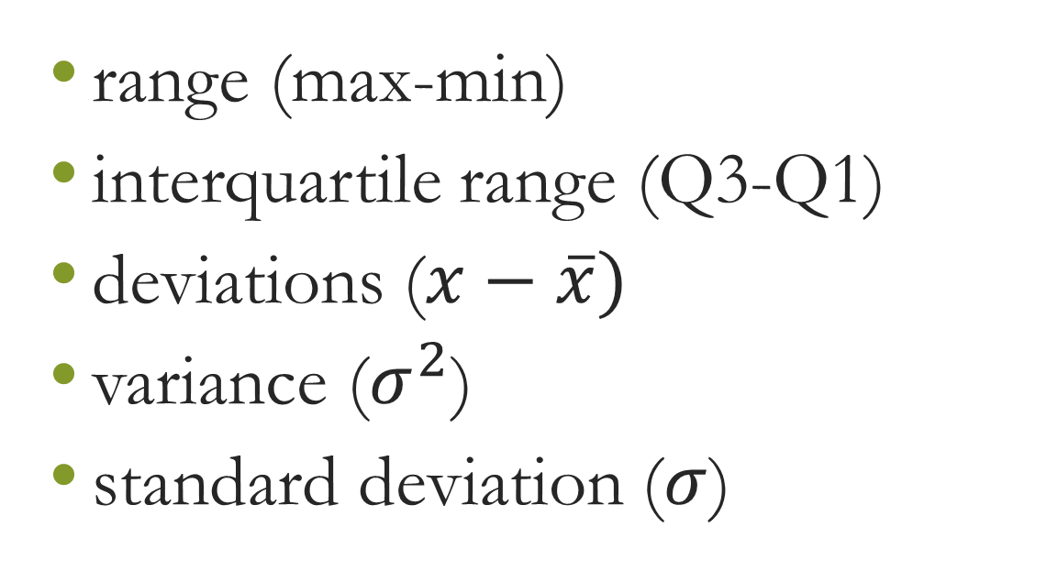
Measures of Variability
Notes:
𝜎的大写是sum 的那个符号

Slide 18
Range (max-min)
It shows the full spread of the data.
But it depends on only the maximum and minimum values, which may be outliers
Notes:
我们可以再描述的细致一点。比如四分之一的点

Slide 19
Measuring Spread: The Interquartile Range (IQR)
A useful numerical description of a distribution requires both a measure of center and a measure of spread.
How to calculate the quartiles:
Arrange the observations in increasing order.
Find the quartiles:
The first quartile Q1 lies one-quarter of the way up the list.
The second quartile Q2 is the median.
The third quartile Q3 lies three-quarters of the way up the list.

Slide 20
How to calculate the quartiles:
Arrange the observations in increasing order.
Find the quartiles: Q1,Q2 and Q3
The interquartile range (IQR) is defined as:
IQR = Q₃ – Q₁

Slide 21
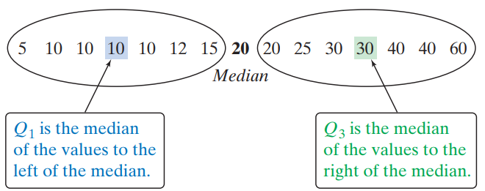
Our North Carolina sample of 15 workers’ travel times, arranged in increasing order, is:
5 10 10 10 10 12 15 20 20 25 30 30 40 40 60
The spread of the middle 50% of the travel times is
IQR=Q3-Q1= 30 - 10 = 20 minutes.

Slide 22
Travel times to work for 20 randomly selected New Yorkers
10 | 30 | 5 | 25 | 40 | 20 | 10 | 15 | 30 | 20 | 15 | 20 | 85 | 15 | 65 | 15 | 60 | 60 | 40 | 45
5 | 10 | 10 | 15 | 15 | 15 | 15 | 20 | 20 | 20 | 25 | 30 | 30 | 40 | 40 | 45 | 60 | 60 | 65 | 85
5 | 10 | 10 | 15 | 15 | 15 | 15 | 20 | 20 | 20 | 25 | 30 | 30 | 40 | 40 | 45 | 60 | 60 | 65 | 85
Q₁ = 15
M = 22.5
Q₃= 42.5
IQR = Q₃ – Q₁
= 42.5 – 15
= 27.5 minutes
Interpretation: The range of the middle half of travel times for the New Yorkers in the sample is 27.5 minutes.

